Slide 1
China’s climate policy initiative: an overview
Zhang Xiliang
Institute for Energy, Environment and Economy
Tsinghua University

Slide 2
China’s climate policy initiative International pledges & national legally binding targets
Copenhagen Climate Conference in 2009
To lower carbon dioxide emissions per unit of GDP by 40-45% by 2020 from the 2005 level; and
To increase the share of non-fossil fuels in primary energy consumption to around 15% by 2020.
Paris Climate Conference in 2015
To achieve the peaking of carbon dioxide emissions around 2030 and making best efforts to peak early;
To lower carbon dioxide emissions per unit of GDP by 60-65% by 2030 from the 2005 level; and
To increase the share of non-fossil fuels in primary energy consumption to around 20% by 2030.
The 12th Five-Year-Plan (2011-2015)
Energy intensity target: reduce 16% relative to 2010
Carbon intensity target: reduce 17% relative to 2010
Non-fossil energy target: 11.4% of non-fossil fuels in primary energy supply by 2015.
The 13th Five-Year-Plan (2016-2020)
Energy intensity target: reduce 15% relative to 2015
Carbon intensity target: reduce 18% relative to 2015
Non-fossil energy target: 15% of non-fossil fuels in primary energy supply by 2020

Slide 3
Policy measures & Institutional arrangements
The 12th Five-Year-Plan (2011-2015)
Disaggregating national targets into provinces;
Yearly progress check and supervision organized by the State Council;
National energy conservation subsidy program;
Find-in tariff for renewable energy electricity;
Electricity surcharge for renewable energy electricity;
Taxes: fossil resources tax and transport fuel tax
Energy efficiency standards: building and transport fuel;
National R&D program: MOST and NSFC; and
Emission trading system pilots in five provinces and two cities
The 13th Five-Year-Plan (2016-2020)
Disaggregating national targets into provinces;
Yearly progress check and supervision organized by the State Council;
Find-in tariff for renewable energy electricity;
Electricity surcharge for renewable energy electricity;
Taxes: fossil resources tax and transport fuel tax
Energy efficiency standards: building and transport fuel;
National R&D program: MOST and NSFC; and
National emissions trading system (ETS)

Slide 4
Primary energy supply

Slide 5
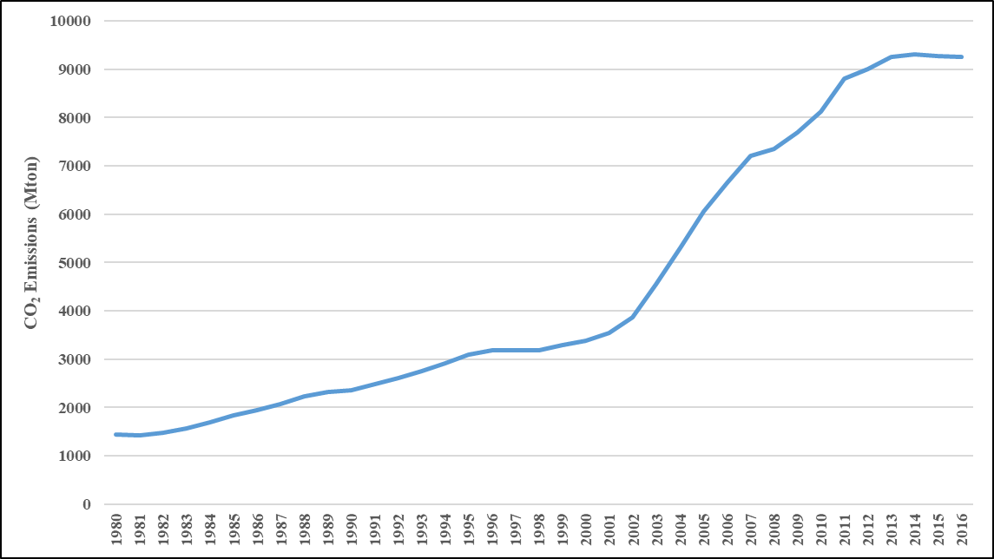
Energy-related CO2 emissions

Slide 6
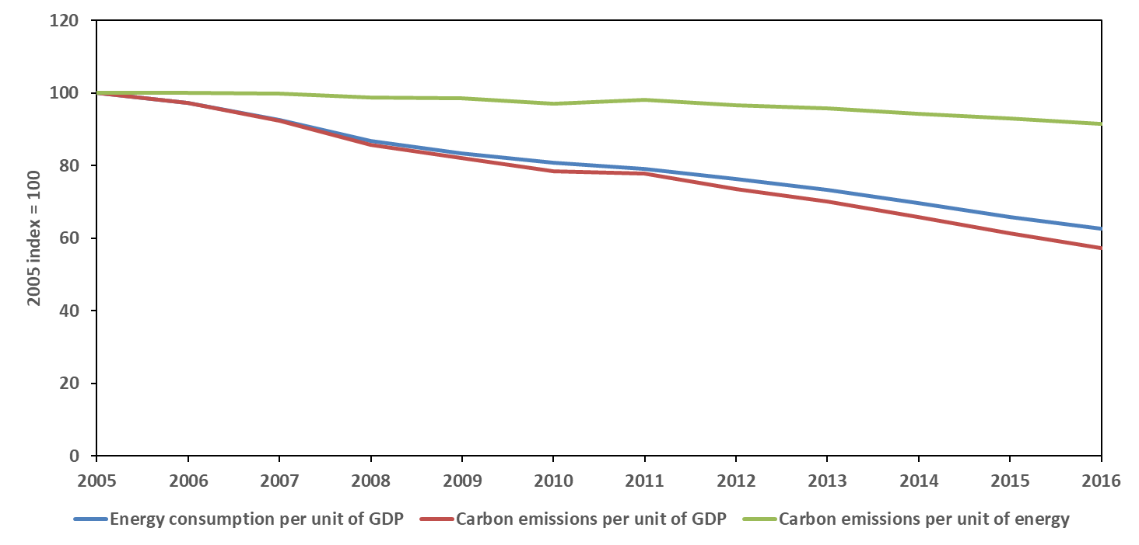
Carbon intensity of economy, Energy intensity of economy, and Carbon intensity of energy
43%
The share of non-fossil fuels in primary energy supply reached 13% in 2016.

Slide 7
CO₂ emissions under different rates of carbon intensity (CI) reduction Scenarios with C-GEM Model

Slide 8
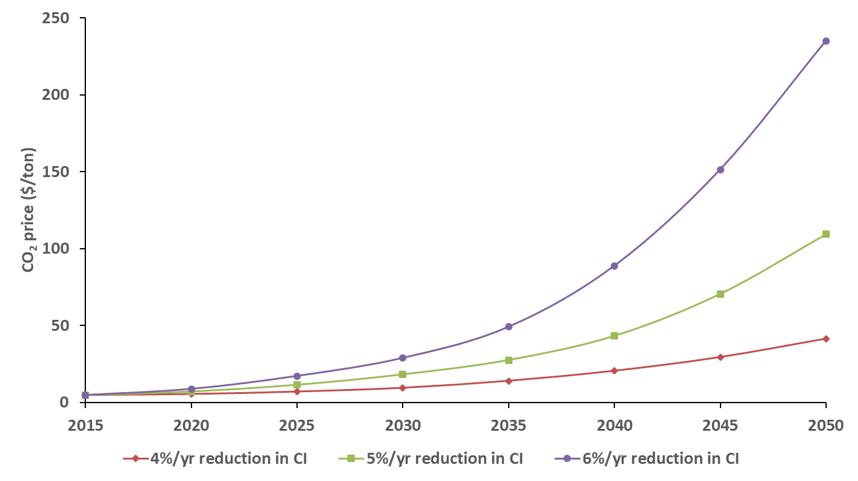
The Carbon Price under different rates of carbon intensity (CI) reduction Scenarios in addition to Feed-in Tariff and Natural gas subsidy

Slide 9
China’s national emissions trading program — A critical policy for the Paris Agreement?
A significant shift from the conventional programs which are often characterized by command-and-control and heavy fiscal subsidy
It will involve 8 sectors and ultimately cover approximately one half of China’s total energy related CO2 emissions;
To establish a nation-wide MRV system;
It will be implement by three stages: Infrastructure construction (one year), system test (one year), development and improvement; and
An important alternative to the national energy conservation subsidy program.

Slide 10
Thank you for your attention.
zhang_xl@tsinghua.edu.cn

