Slide 1
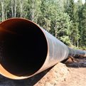
Update on Views for Paris: Policy Implications European Union

Slide 2
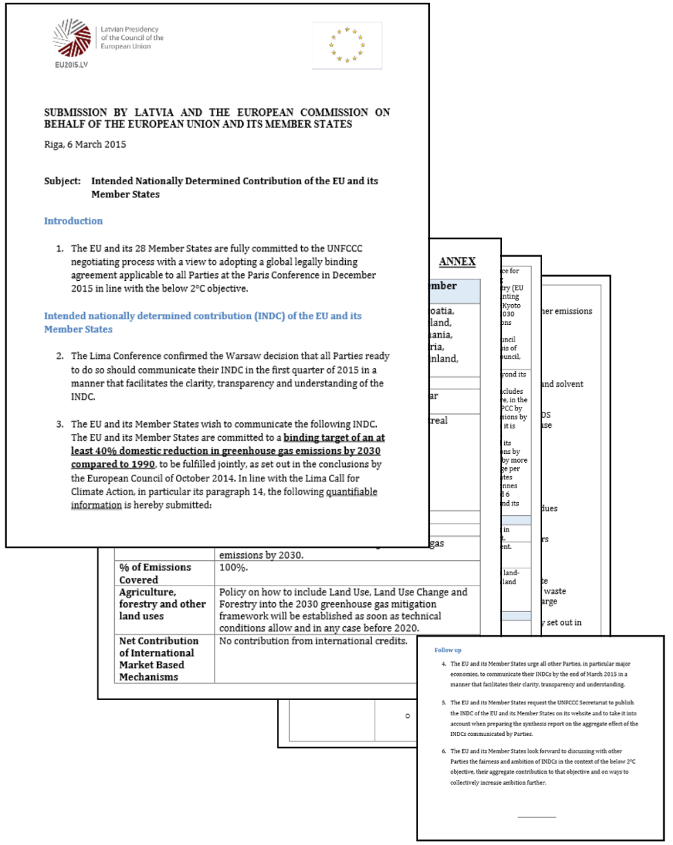
Current NDC
Submitted in March 2015
Joint fulfillment by all Member States (Art. 4 PA)
GHG emissions reduction: 40% below 1990 by 2030
All GHGs outside Montr. Prot.
ETS: -43% below 2005
Non-ETS: -30% below 2005
No international credits
Uncertainty around LULUCF
Climate Action Tracker: “Insufficient”

Slide 3
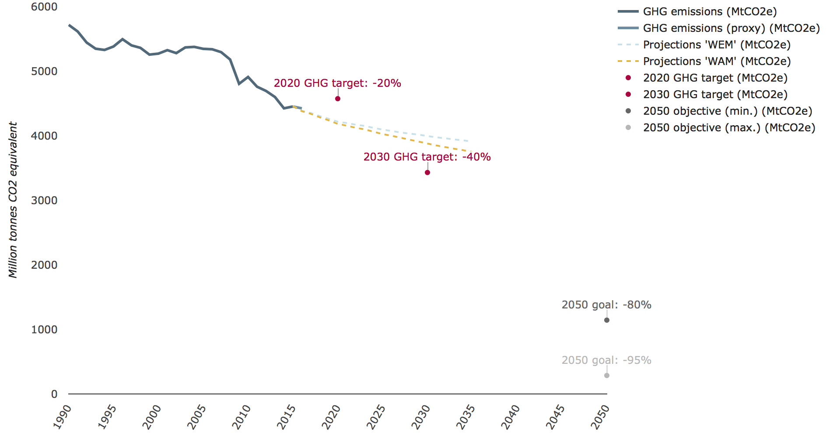
Emissions Trend
Source: EEA, Nov. 2017

Slide 4
Assessment and Outlook
Favorable trend 1990-2014, but recent setbacks
>20% drop in emissions, >45% economic growth
~6.5 tCO₂e per capita, lower than China
IEA 3/2018: emissions increase of 1.5% in 2017
2030 Climate and Energy Framework
Progress on EU ETS, but ongoing debate about non-GHG targets, Climate Action Regulation, Energy Union
European Council 3/2018: Calls for 2050 Strategy
Pressures on EU integration, shifting priorities
Sibiu, March 2019: Summit on the Future of Europe
Next EU NDC: German Presidency of the EU in S2/2020

Slide 5
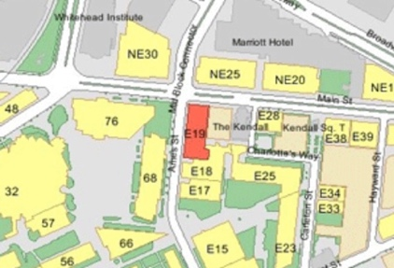
Thank You!
Center for Energy and Environmental Policy Research
Massachusetts Institute of Technology (MIT)
MIT Building E19-411
400 Main Street, 4th Floor
Cambridge, MA 02142-1017
🌐 http://ceepr.mit.edu ✉ ceepr@mit.edu
617-253-3551  617-253-9845

