Slide 1
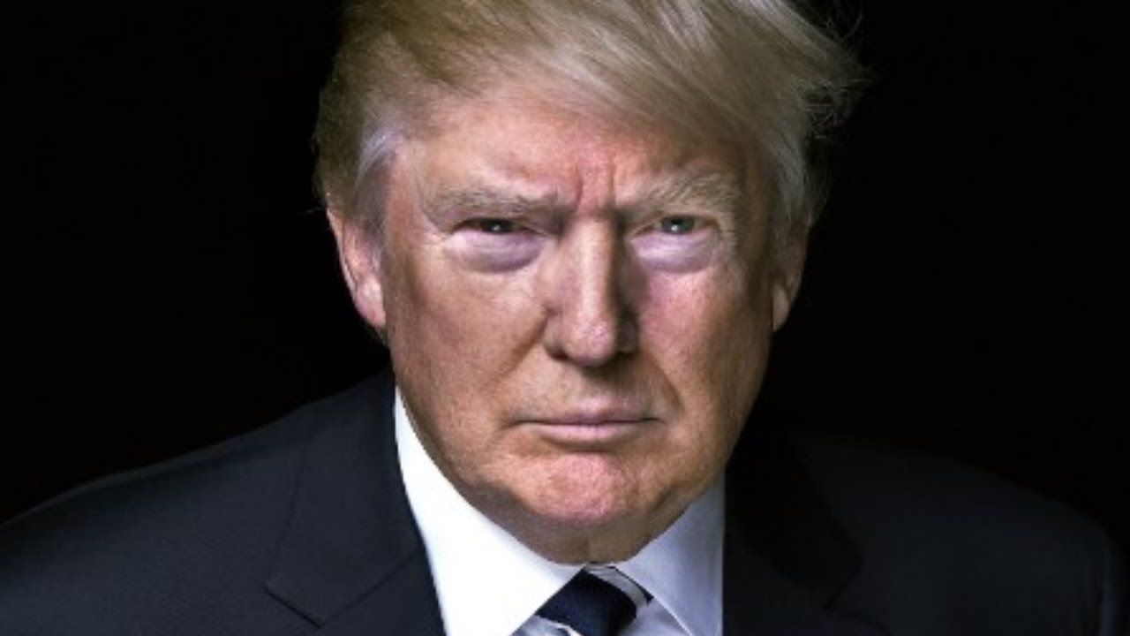
Climate Change
In the Trump Era: Dark Clouds, Silver Linings, Hail Mary’s, Red Flags
Notes:
“dark clouds, silver linings, red flags, hail mary’s
Implications
Dark clouds:
OBIOUSLY PARIS AGREEMENT. ONE OF THE MOST SHAMEFUL MEOMENTS
Beyond pulling out, whch may get countermanded
We are not on pace to meet our 2025 goals slide
And in no positin to lead on review and ratchet

Slide 2
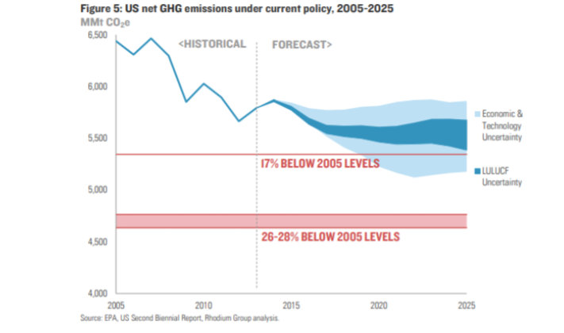
Notes:
Rhodium group, using epa data
This isn’t particularly new, we knoew at end of aobama that additional policies were going to be needed to get us to 2025 goal
But what is so distressing opfcourse is that trump’s policies are moving us farther away

Slide 3
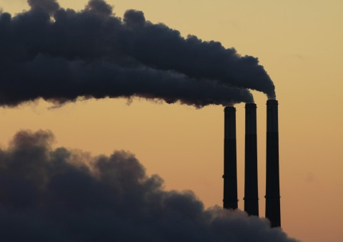
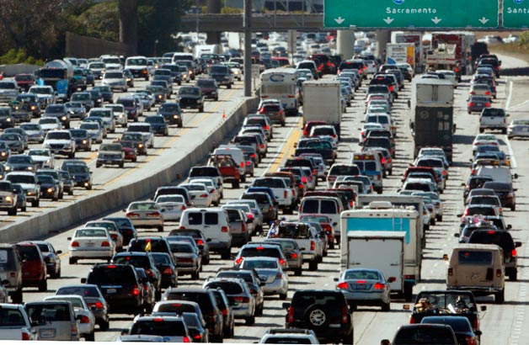
REGULATORY
ROLLBACKS
Notes:
ROLLBACK OF REGULATIONS
UNFORTANTELY, MOST OF THE GAINS DURING OBAMA CAME IN REGULATIONS. BUT AS ONE PRES CAN ISSUE REGS, ANOTHER CAN UNDO
TRUMP AND SCOTT PRUITT DOING THAT WITH A VENGEANCE
CLEAN POWER PLAN
FUEL ECONOMY STANDARDS FOR OUR CARS
Metehane rule

Slide 4
Projected U.S. Carbon Dioxide Emissions
Notes:
Parrticularly stuck on TRANSPOTATION, NOW THE BIGGEST SOURCE
VMT INCREASING
GAS GUZZLERS INCREASING DUE TO LOW GAS PRICES
DECENTRALIZED, UNLIKE POWER PLANTS, HARD TO CONTROL
AND NOW WE ARE IN A BIG FIGHT OVER FUEL ECON
BIGGEST AND MOST IMPORTAT BATTLE—WHY—SHEER NUMBER OF EMISSIONS AT STAKE AND PRIVATE SECTOR WONT DO IT ON ITS OWN
NO CHANCE OF MEETING GOALS WITH TACKLING IT
NEXT SLIDE

Slide 5
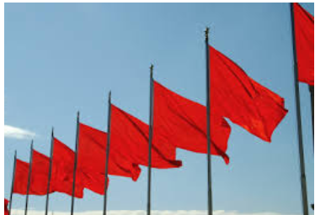
Notes:
Add to this some red flags—
solar tariff, steel tariffs,
tax bill effects on rewneabe enrgy financing, and
And lackluster implementation of historic HFC agreement in light of a bad court decision
perhaps new ideas to boost coal, gas and oil at expense of clean energy , as the phrase “energy dominance” seems to be about fossil energy dominance, not wind, solar, hydro, or storage

Slide 6
Notes:
SIVER LINING
FIRST AND FOREOST, OUR ENERGY SECTOR IS GETTING CLEANER
RECET ESTIMATES 28% BELOW 2005 LEVLES, CLOSE TO WHERE CPP WAS GOING TO GET US BY
UTILITIES ARE SIGNING VERY COST EFFECTIVE CONTRACTS FOR WIND AND SOLAR
COAL PLANTS CONTINUE T CLOSE at rapid pace
CLICK

Slide 7
%
2/3
%
%
%
Notes:
AND INCREASINBLGY, THE CAPACITY IS REPALCED BY RENEWABLES
AND SO, IN CONTRAST TO TRANSPORTATION, WE SEEM TO BE ON TRACJ
AND TWO NEW THINGS TO ADD TO SILVER LINING COLUMN
Thus far, FERC has said no to coal subsidies and said yes to energy storage
In recent budget, congress made some surprising boosts in clean energy r and d, coming close to realizing us pledge at paris agreemene to double innovation spending

Slide 8
Clean Energy Successes
Notes:
BLUE STATES LIKE CA, OR, NY MA: 50% BY 2030
MA—MASSIVE COMMITMENT TO LONG TERM K FOR OFFSHORE WIND 1.6 GW, OTHER FOLLOW
BUT PURPLE STATES TOO LIKE ILL
AND RED ONES --
NC now ranks 2D^{h} in the nation for SOLAR
TEXAS—phenomenal 7 billion public investment in wind—10%
iowa 40%
BEST THING—ITS BIPARTISAN THSE ARE THE SUCCESS STORIES THAT LAY GROUND FOR NATIONAL

Slide 9
Cumulative Corporate Renewable Energy Purchasing In The United States, Europe, and Mexico–November 2016
Source: Bloomberg New Engergy Finance *Google total also includes one 80 MW project in Chile
Notes:
BUSINESSES GET THIS THEY ARE PUTTING THEIR MONEY WITH THEIR MOUTHS ARE, EG. GOOGLE ONE HUNDRED PERCENT RENEWABLE BY 2018

Slide 10
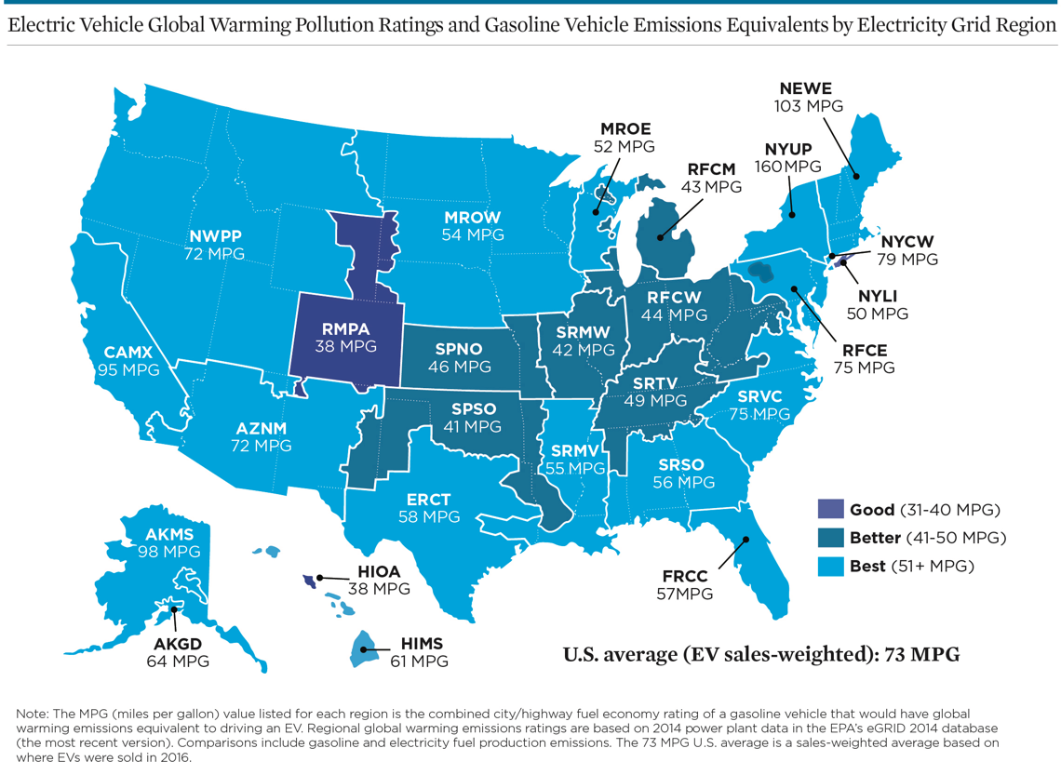
Notes:
AND EVEN ON THE MOST STYCK PART—TRANSPORTATIO, GOODNEWS—WE HAVE TECHNOLOGY ELECTRIC VEHICLES, NOT JUST CARS BUT BUSES, TRUCKS, ARE ALSO A GREAT SOLUTION AND GETTING BETTER
THIS SLIDE DEPICTS IT—UCS DID LIFE CYCLE ANALYSIS WOULD NEED TO DRIVE AN ICE CAR THAT DSNT EXIST NATIONALLY –80 MPG

Slide 11
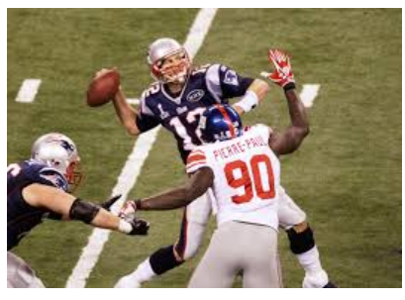
Notes:
And a hail Mary—climate litigation
DESCRIBE THE CASES AND EXTRAORDINARY TURN OF AFFIARS
And andother hail mary—AV’s take oever and turnover the fleet very rapidly from sole driven ICE to shared electric

Slide 12
New Focus: Transportation is the Problem
Notes:
Hold back dereg as much as we can, e.g. fuel econ is a winnable fight, due to CA POST 2025 STANDARDS MUST GET A LOT STRONGER
GOT TO SCALE UP ELECTRIFICATION AND ACCELERATE IT
Expanding ev tax credit
National investment in infrastructure

Slide 13
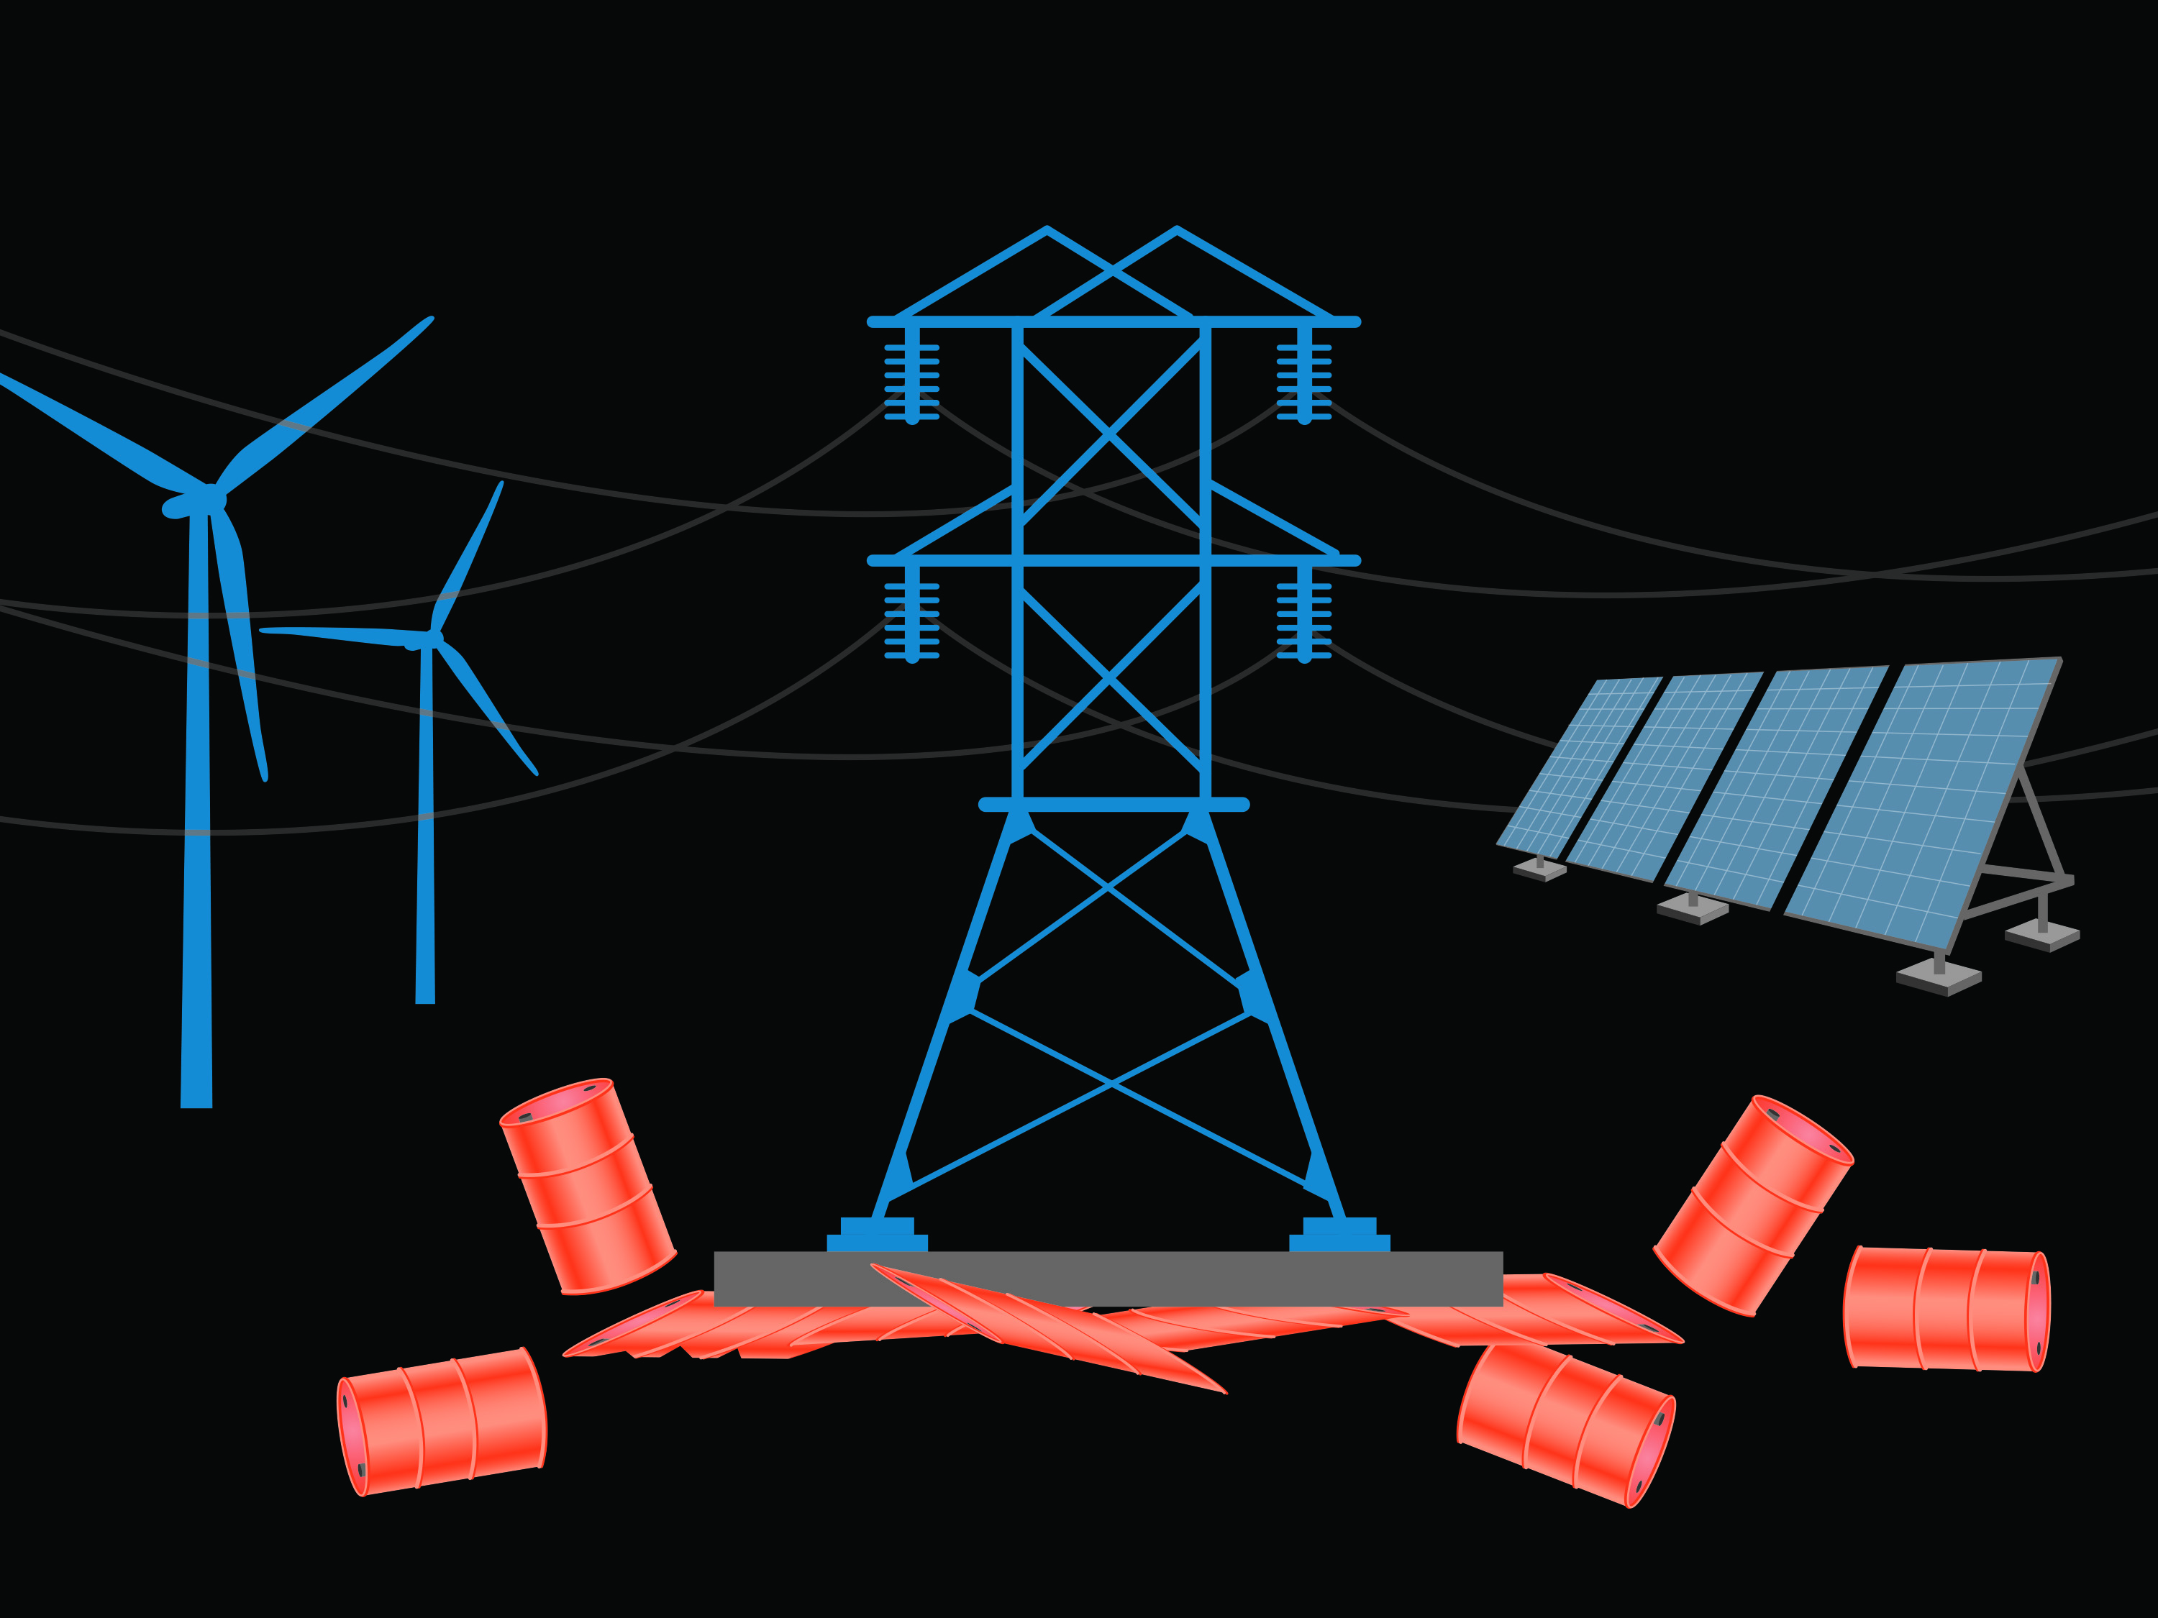
New Allies
Notes:
\
OUR BEST ALLY SO FAR IS LARGELY UNTAPPED—ELETRIC INDIUISTRY
HERE’S THE GOOD NEWS—UTLITIES ARE MONOPOLIES, IN EXCHANGE FOR MONOP THEY HAVE TO SERVE THE PUB INTERST. AND THE PUB INTEST IS TO ELECTRIFY TRANSPORTATION, AND EVENTUALLY HEAT THEY WORK FOR US
AND WE CAN GUIDE THEM TO PUSH THE TRANSITION

Slide 14
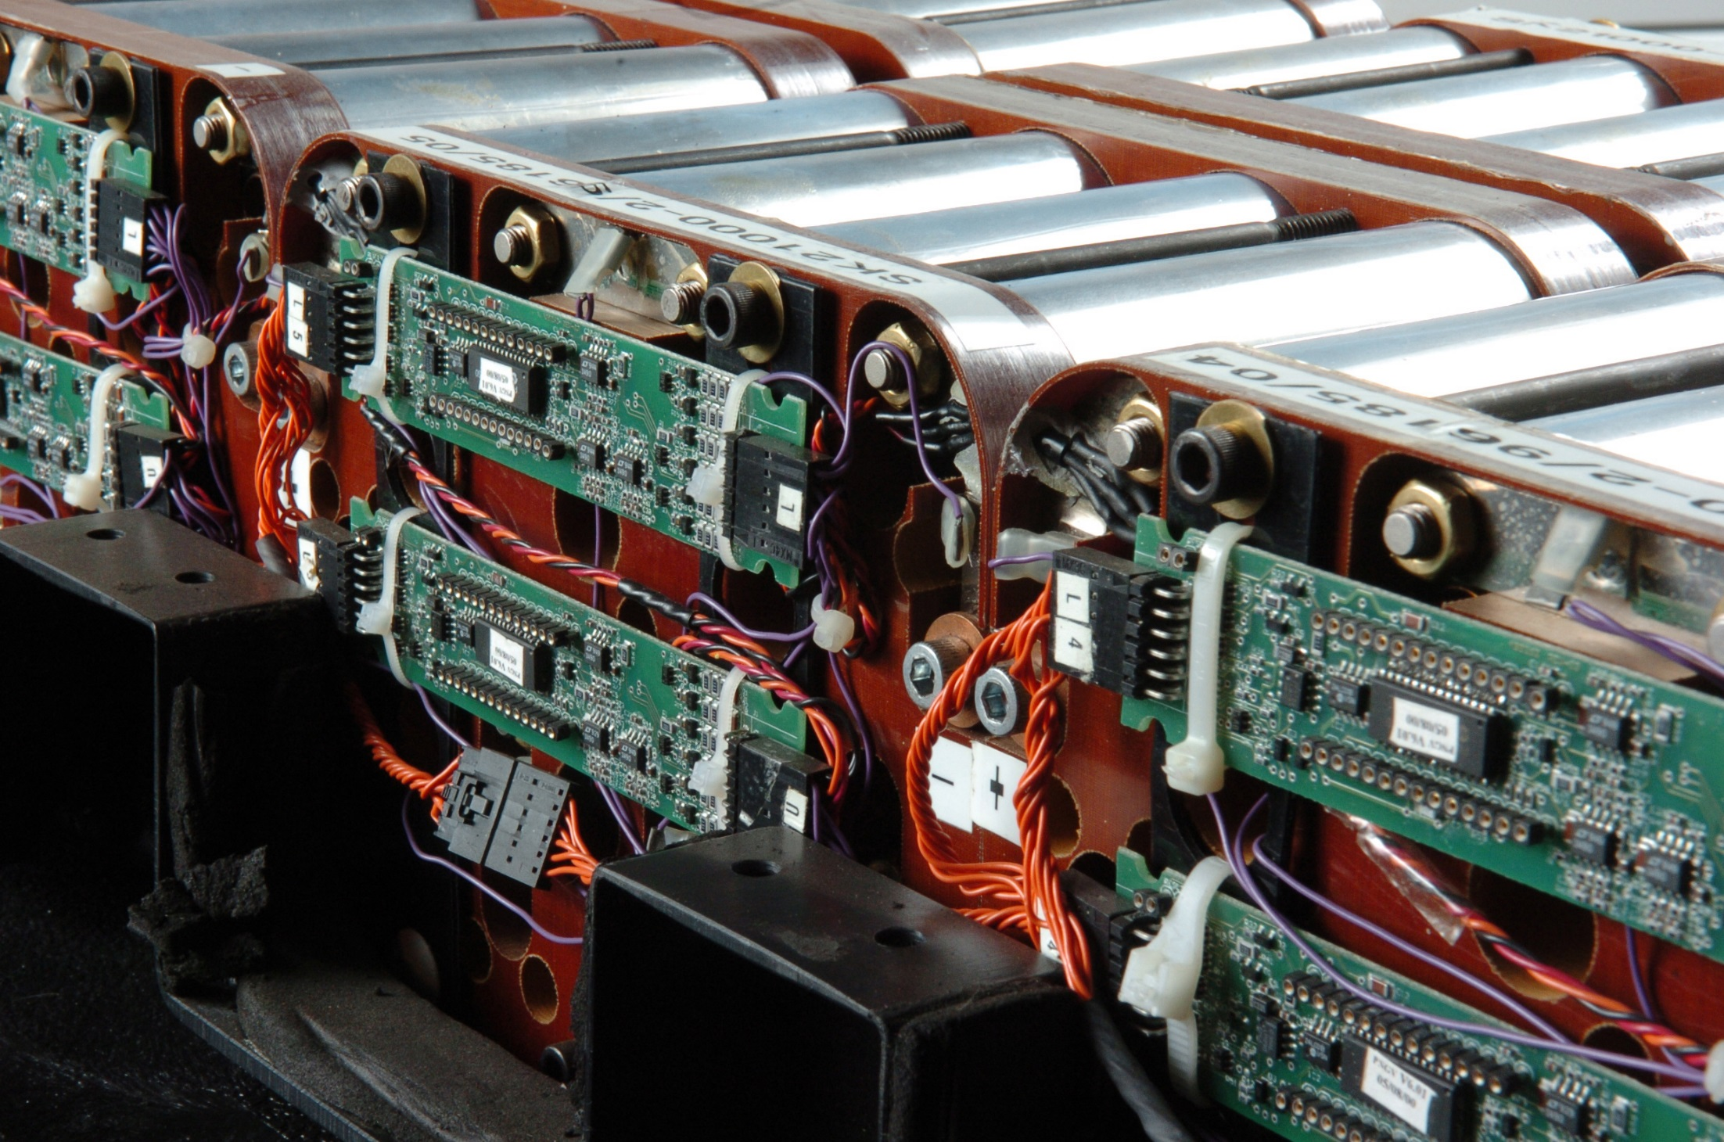
New Technologies
Notes:
MODERNIZE THE GRID TO TAKE FULL ADVANTAGHE OF RENEWABLES,
INVST IN NEW TRANSMISSION,
ADVANCE NEW TECHNOLOGIES AND USE THEM TO OUR ADVANTAGE
ENERGY STORAGE—CAN REVOLUTIONIZE ENERGY. This is a high-powered lithium-ion HEV batteries being tested by Argonne National Laboratory, the goal being to lower the cost and increasing the lifetime and safety of the battery.
IF WE CAN GET THIS RIGHT, GAME OVER FOR FOSSIL FUEL
AND CCS—CONGRESS PASSED A VERY GENEROUS TAX CREDIT

Slide 15
Notes:
And, when the time is right, I’M HOPING 2021,
NATIONAL CIMATE POLOICY THAT INCLUDES, AMONG OTHER THINGS
putting a national price on carbon,
Thank you…

