Slide 1
Challenging Sectors for Mitigation: Agriculture, Forestry, and Other Land Uses
Gary M Pierzynski, P.V.V. Prasad, C.W. Rice, B. Lynn, and R. Lollato

Slide 2
Outline
Emissions from Agriculture, Forestry, and Other Land Uses
Strategies for Reducing Emissions
Challenges for Reducing Emissions
Summary

Slide 3
Required Increases in Agricultural Production
Region | 2005 | 2050 | 2005-2012 | 2013-2050
 | ------------------------------------------- % -------------------------------------------
World | 100 | 163.4 | 14.8 | 48.6
SSA and S. Asia | 100 | 232.4 | 20.0 | 112.4
Rest of World | 100 | 147.9 | 13.8 | 34.2
Assumes 9.73B population in 2050; Source: FAO Food Trends 2017

Slide 4
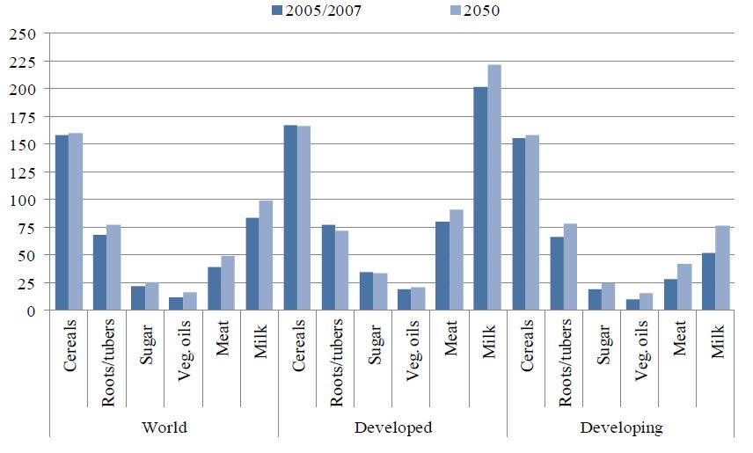
Per Capita Food Consumption (kg/person/yr)
Source: FAO, 2012

Slide 5
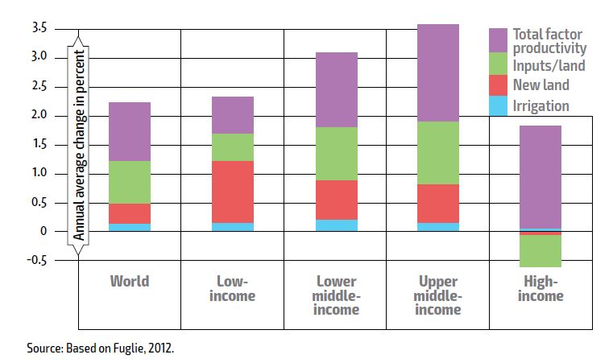
Sources of Growth in Agricultural Production, 1961-2010

Slide 6
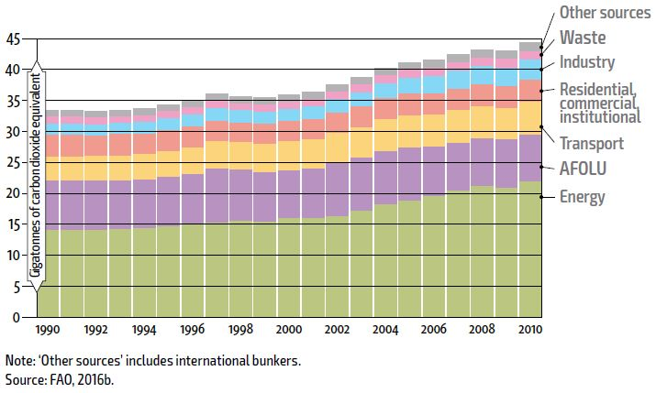
Annual GHG Emissions, All Sectors

Slide 7
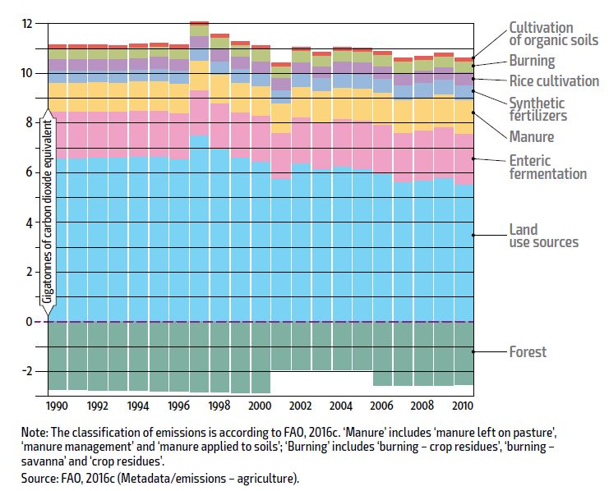
Annual GHG Emissions Ag, Forestry and Other Land Uses

Slide 8
Anthropic Sources of Methane and Nitrous Oxide Globally
CH₄
N₂O
Biomass
burning
Industry
Industry
Cattle &
feedlots
Rice
cultivation
Energy
Waste
treatment
Biomass
burning
Other
combustion
Enteric
fermentation
Landfills
Agricultural
soils
Agriculture
Agriculture
Total Impact 2.0 Pg C_{equiv} 1.2 Pg C_{equiv}
(compare to fossil fuel CO₂ loading = 3.3 Pg C per year)
(compare to soil C sequestration of 0.3-0.5 Pg C per year)
Source IPCC 2001; from Robertson 2004
Notes:
Important Points:
Human-caused impacts on the concentrations of methane and nitrous oxide in the atmosphere are huge, on the same order of importance as the annual increase in atmospheric CO2 from fossil fuel use (about 3 petagrams carbon per year)
Agriculture dominates both fluxes: >50% of methane and >75% of nitrous oxide are from agricultural sources
There is thus a huge potential for agriculture to contribute to greenhouse gas mitigation.
For additional information: Phil Robertson; robertson@kbs.msu.edu; 269 / 671-2267.

Slide 9
Strategies

Slide 10
Mitigation activities in the AFOLU sector
Reductions in CH₄ or N₂O emissions from croplands, grazing lands, and livestock.
Conservation of existing carbon stocks, e.g., forests, peatlands, and soil.
Reductions of carbon losses through management changes or by reducing losses of carbon-rich ecosystems.
Enhancement of carbon sequestration in soils, biota, and long-lived products.

Slide 11
N management to reduce N₂O
Timing
Split applications
Delayed applications
Use nitrification inhibitors
Placement
Banded
Injected
Utilized N from organic matter efficiently
Soil, crop residue, cover crops

Slide 12
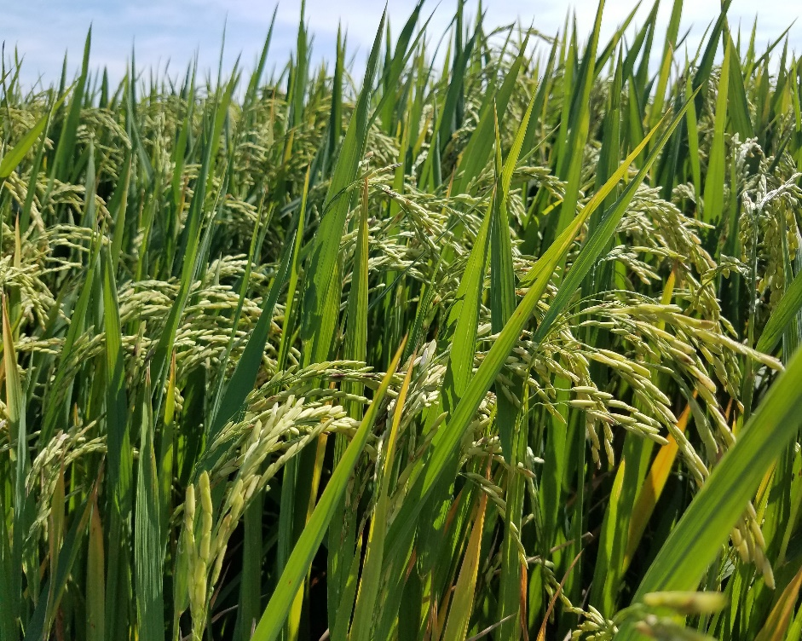
Methane/N₂O Emissions from Rice: Opportunities
Water management
Soil management – tillage
Fertilizer placement
Inhibitors/additives
Genotypic differences
Genetic manipulation

Slide 13
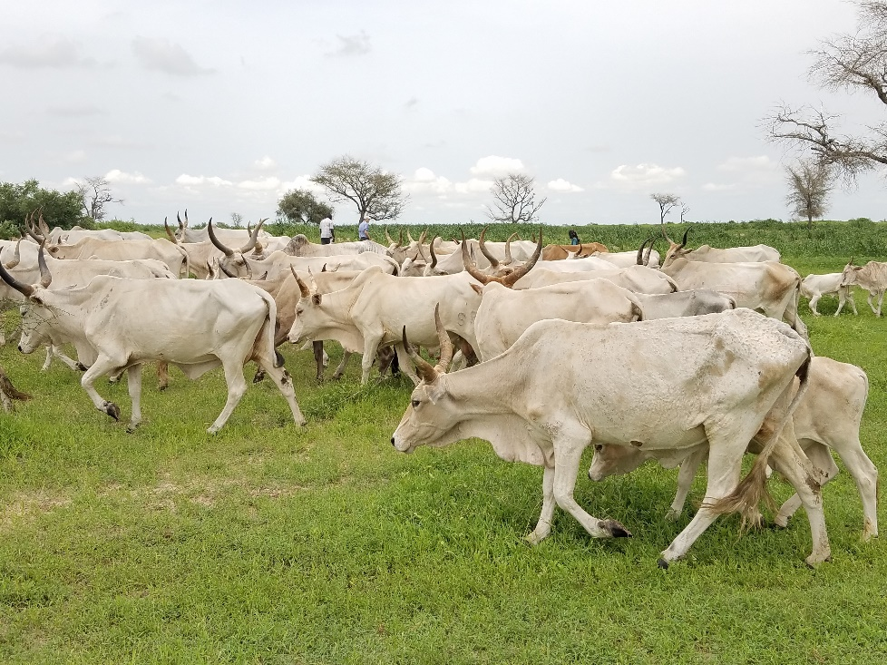
Methane/N₂O Emissions from Livestock: Opportunities
Land management/use
Diet intensification
Diet additives
Genetic selection
Immunization
Antimicrobials

Slide 14
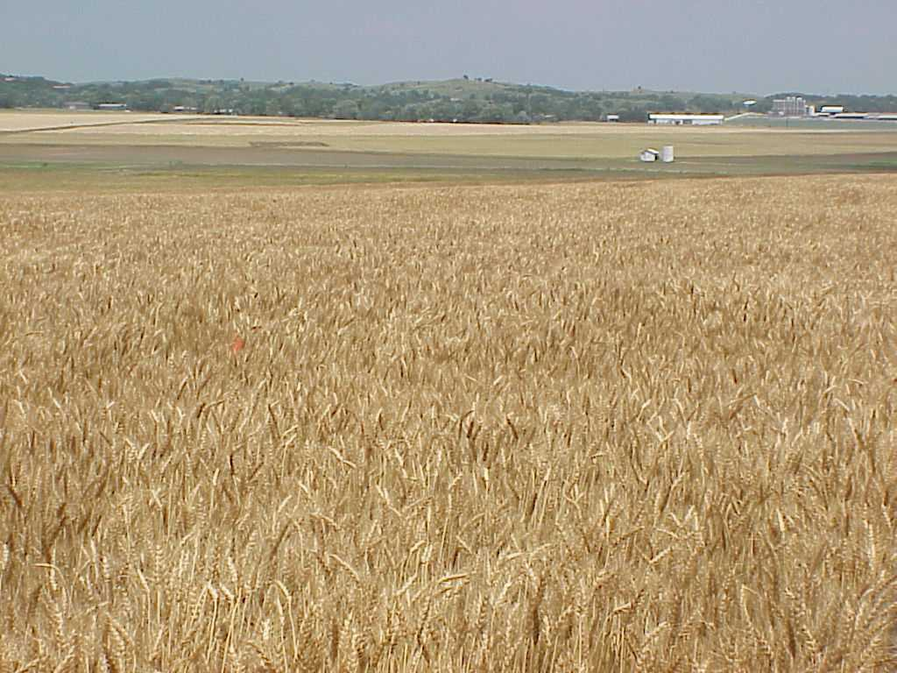
Management Strategies for C Sequestration
Develop Management Programs that:

Slide 16
Sustainable Intensification
Valued outcomes maintained/increased while maintaining/improving environmental outcomes
Intensive, semi-subsistence, subsistence
Interventions

Slide 17
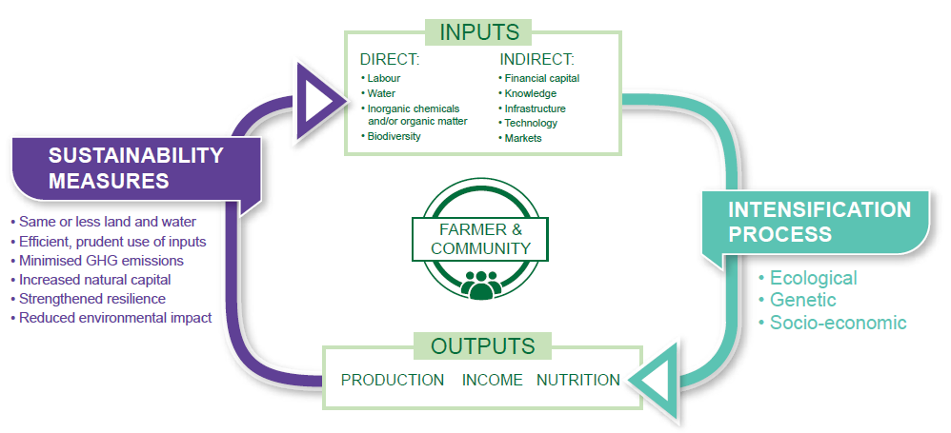
Sustainable Intensification: Frame Work
The Montpellier Panel 2013. Sustainable Intensification: New Paradigm for African Agriculture. London: Agriculture for Impact.
Sustainable intensification will help improve productivity and resilience of small holding farmers.
Slide: Prasad, 2014

Slide 18
Challenges
Global food system is complex: Trade-offs
Agricultural production systems vary tremendously within short distances
Solutions are local but need large-scale adoption of many interventions and wide-spread adoption of single interventions
Barriers to adoption of interventions difficult to overcome

Slide 19
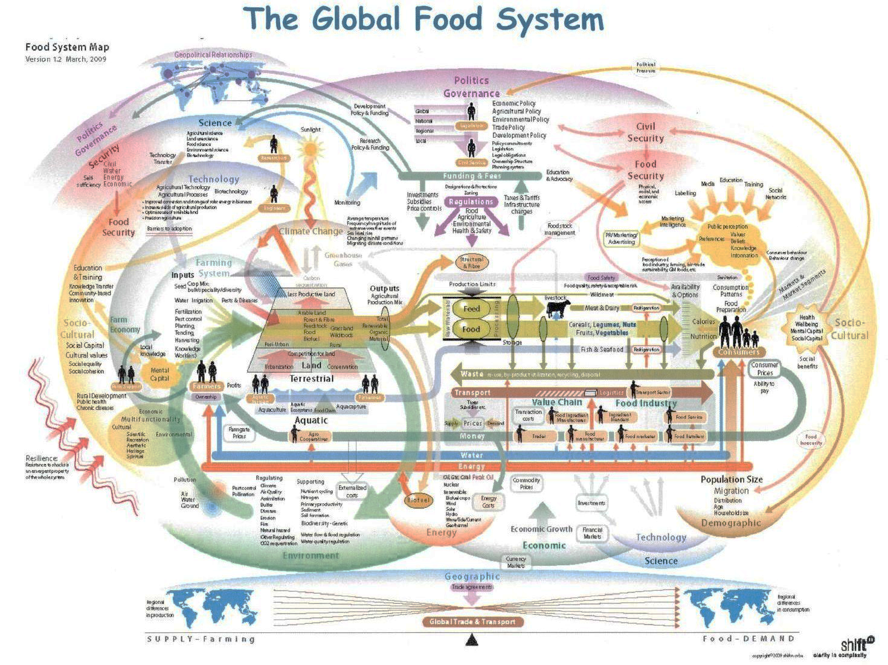

Slide 20
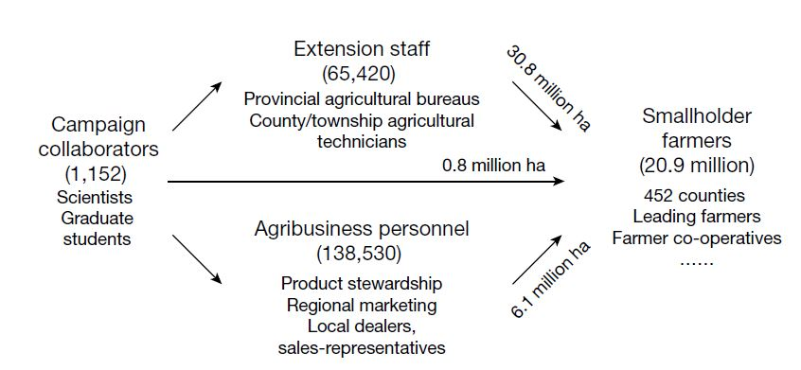
Large-Scale Interventions
 |  | Maize | Rice | Wheat | Total
Area (million ha) |  | 12.8 | 17.0 | 7.9 | 37.7
Grain (Mt) | FP | 108 | 133 | 51 | 292
 | ISSM | 120 | 147 | 56 | 324
 | Diff (%) | 11.6 | 11.1 | 10.8 | 11.2
N Use (Mt) | FP | 2.9 | 3.3 | 1.8 | 9.0
 | ISSM | 2.5 | 2.8 | 1.5 | 6.8
 | Diff (%) | -14.7 | -15.1 | -18.1 | -15.6
CO₂ equiv (Mt) | FP | 45 | 125 | 28 | 198
 | ISSM | 39 | 119 | 24 | 183
 | Diff (%) | -12.9 | -4.6 | -13.2 | -7.7
Source: Cui et al., 2018 doi:10/1038/nature25785

Slide 21
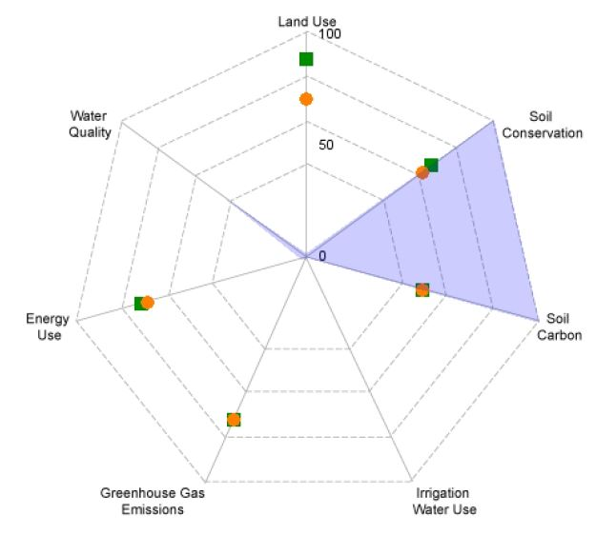
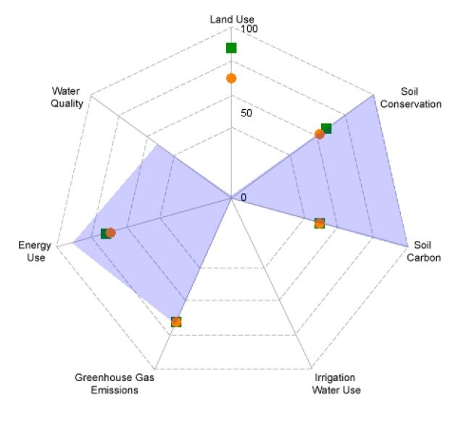
FieldPrint® Platform
0 lb N/ac
85 bu/ac
0 lb CO₂e/bu
125 lb N/ac
83 bu/ac
9.7 lb CO₂e/bu

Slide 22
Summary and Conclusions
Agricultural production contributes ~13% GHG emissions
Effective strategies exist to reduce GHG emissions from agriculture
Challenges relate to wide spread adoption of interventions that will have a significant impact

