Slide 1

Market Cost of Renewable Jet Fuel Adoption in the US
Challenging Sectors for Mitigation
XLI MIT Global Change Forum
March 28, 2018
Niven Winchester
niven@mit.edu
http://globalchange.mit.edu/

Slide 2
Outline
Aviation
Construction
Land use change

Slide 3
1. Aviation
Air passenger travel is expected to increase by 3.6% per year over the next 20 year (IATA, 2017)
The global aviation industry aims to achieve carbon neutral growth by 2020 and reduce carbon dioxide (CO₂) emissions by 50% relative to the 2005 level by 2050 (IATA, 2009)
Aviation biofuels present an avenue to reduce aviation emissions

Slide 4
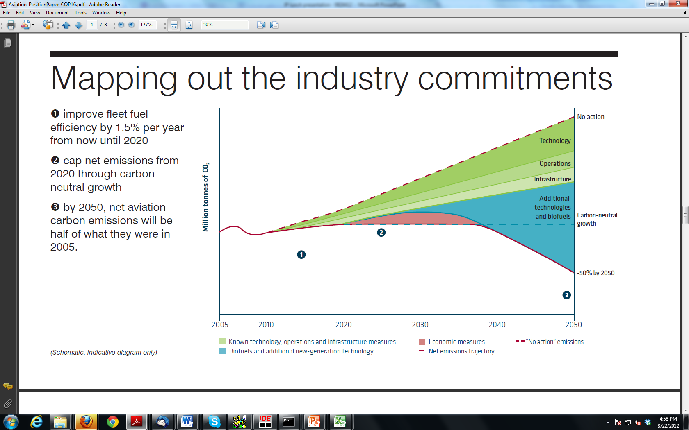
1. Aviation
Emissions reduction roadmap
Note: Schematic, indicative only.
Source: Air Transport Action Group (2010, p.4).

Slide 5
1. Aviation
Biofuel production and abatement costs
Fuel | Cost (2015$/gal.) | Biofuel price premium | kg of CO₂e per gal. | Gallons per ton of abatement | Abatement cost (2015$/t)
Conventional jet | $1.07 | - | 11.5 | - | -
HEFFA | $2.82 | $1.75 | 4.8 | 149.3 | $261.69
Fisher-Trospch | $4.60 | $3.53 | 3.2 | 120.5 | $425.30
Advanced fermentation | $5.88 | $4.81 | 2.4 | 109.9 | $528.94
Source: Author’s calculations based on Winchester, N., R. Malina, M. Staples and S.R.H. Barrett (2015). The impact of advanced biofuels on aviation emissions and operations in the United States, Energy Economics, 49, 482-491.
Biofuel abatement costs depend on their price premium and lifecycle greenhouse gas emissions (measured in tons of CO₂ equivalent), relative to conventional jet fuel
Biofuels are an expensive emissions abatement option relative to market-based measures

Slide 6
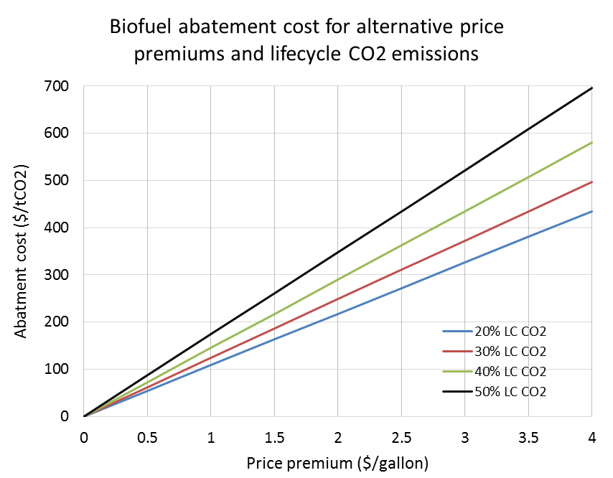
1. Aviation
  Large reductions in the biofuel price premium and/or lifecycle (LC) CO₂ emissions are needed for biofuels to compete with market-based measures

Slide 7
1. Aviation
Current efforts to meet aviation emissions targets focus on purchasing emissions credits from other sectors
The 39th Assembly of the International Civil Aviation Organization (ICAO) agreed to a market-based measure known as the Carbon Offsetting and Reduction Scheme for International Aviation (CORSIA) in 2016
Issue: The offset system proposed by ICAO does not provide appropriate incentives to reduce emissions (and is not the least cost way to achieve carbon neutral growth)
  As the quantity of offsets each airline has to purchase is based on industry-wide emissions, the incentive for an airline to reduce emissions is very small

Slide 8
1. Aviation
Additional airline offset requirements due to a one-unit increase in CO₂ emissions for alternative airline emissions shares
Offset requirements for each ton of additionally emissions are initially much less than one

Slide 9
1. Aviation
Winchester (2017)* outlines a benchmark CO₂intensity system with tradable permits that will incent in-sector all emission abatement options that cost less than the social cost of carbon, and can operate concurrently with the CORSIA
* Winchester, N. (2017). A Win-Win Solution to Abate Aviation CO2 Emissions, MIT JPSPGC Report 318. (https://globalchange.mit.edu/publication/16754)

Slide 10
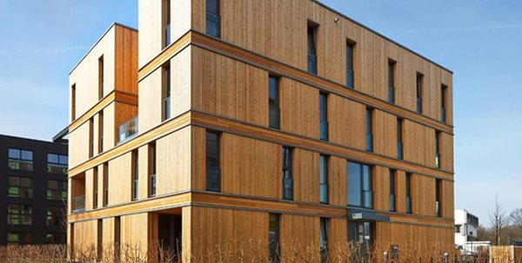
2. Construction
Building materials such as cement, steel and aluminium are energy intensive, and it is difficult to eliminate emissions from these sectors
Carbon capture and storage (CCS) is one option, but this technology is expensive, and construction inputs lack the economies of scale available in electricity production
Substitution towards less CO₂-intneisve building materials – such as Cross Laminated Timber (CLT) – provides an opportunity to reduce emissions from construction activities

Slide 11
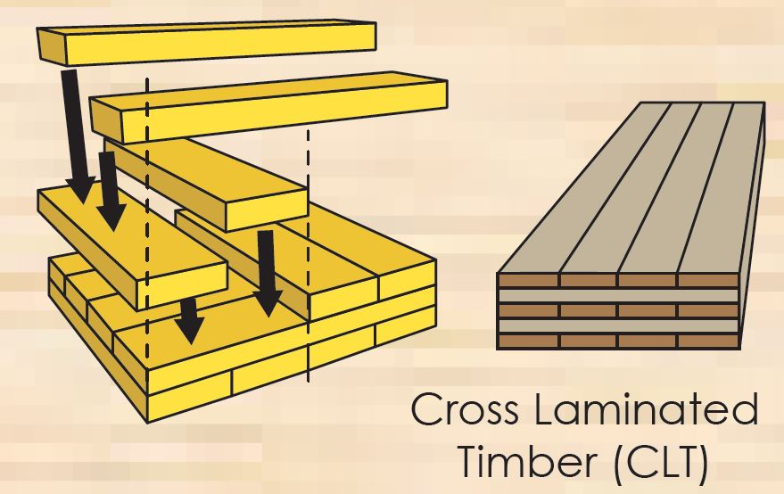
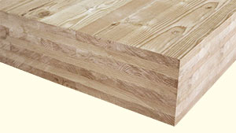
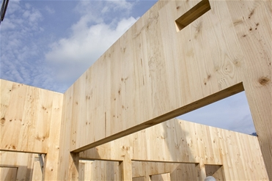
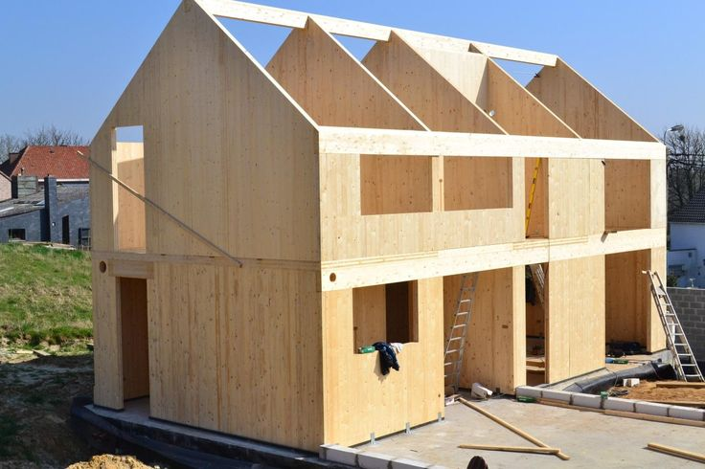
Cross-laminated timber

Slide 12
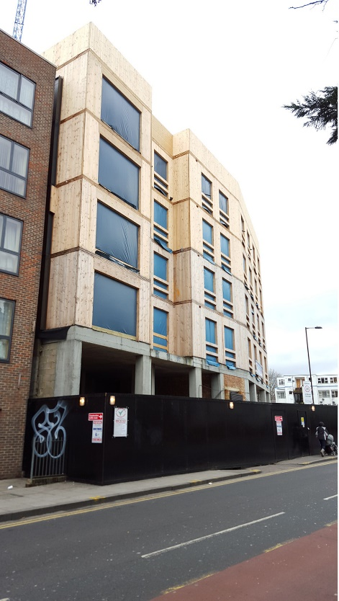
2. Construction
Cross-laminated timber (CLT) is a wood panel product made from solid-sawn lumber
CLT makes it possible to build mid-rise wooden structures
  33 m high, 121 unit apartment block in London (Dalston Lane)
  12-story CLT building planned for Portland, Oregon (Framework)
  52 m high CLT office building planned for Wellington, New Zealand
CLT is able to substitute for steel, concrete, and metal products in construction and thus provides a opportunity to mitigate GHG emissions

Slide 13
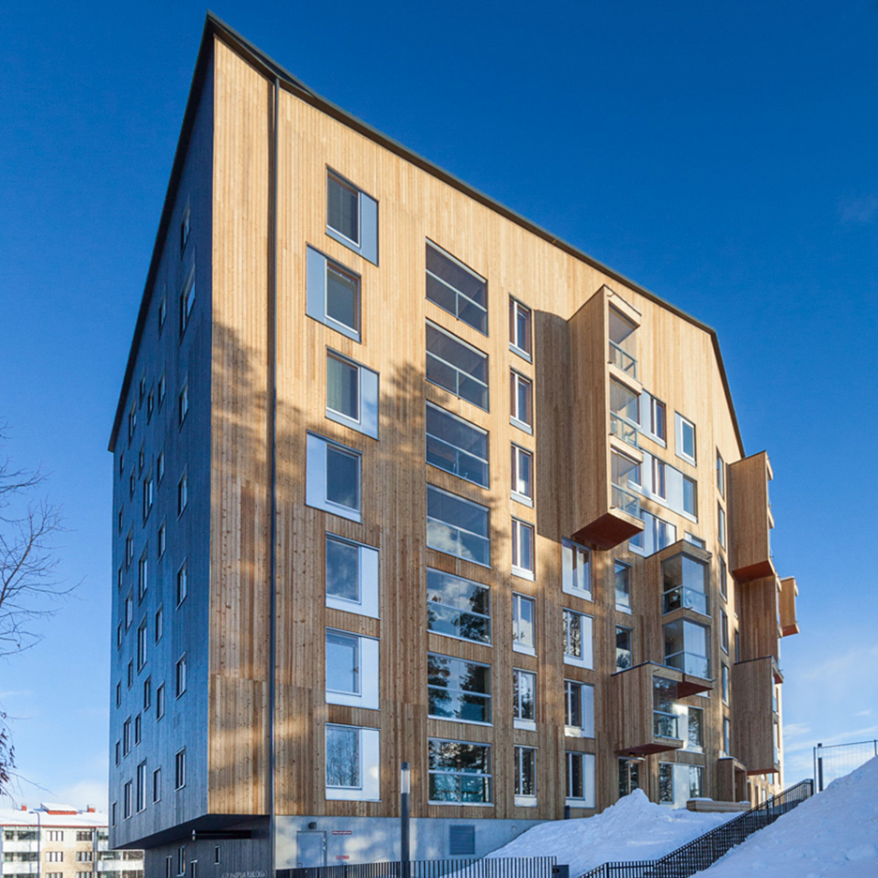
Jyväskylä, Finland

Slide 14
Results
2. Construction
Winchester and Reilly (2018)* examine the scope for CLT to reduce emissions in the construction industry
The analysis simulates emission reductions consistent with the US Nationally Determined Contribution (NDC) in 2030 with and without substitution among building materials
* Winchester, N. & J.M. Reilly, (2018). The greenhouse gas benefits of using lumber in construction, in press.

Slide 15
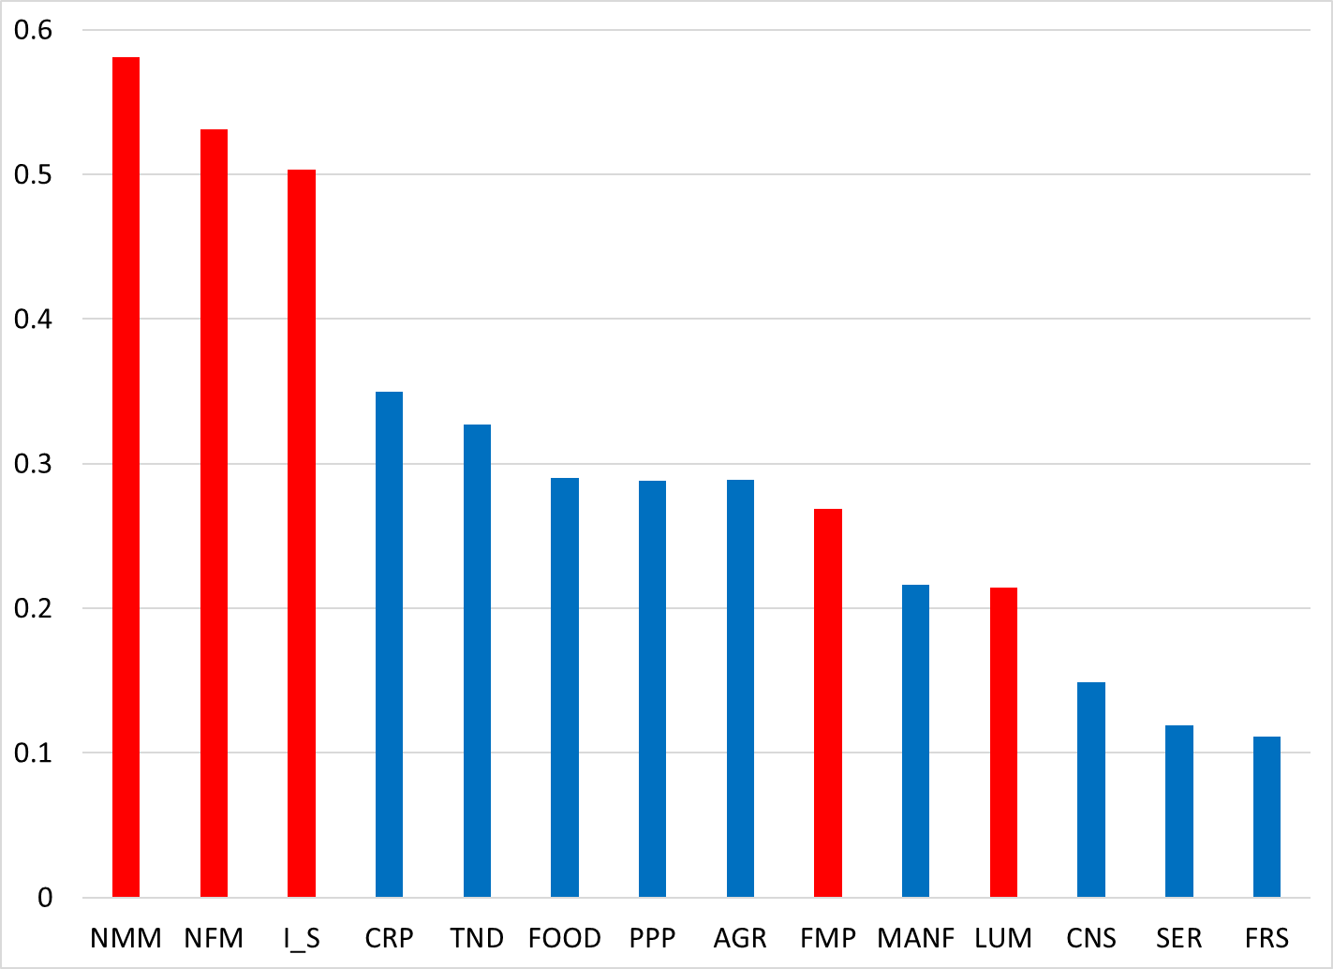
Lifecycle CO2 emission intensities, t per thousand $ of output
Cement
Aluminium
Iron and steel
Lumber

Slide 16
2. Construction
Economy-wide results, 2030
 | No substitution | Substitution | Change due to substitution
CO₂ price (2011$/tCO₂) | 93.66 | 93.54 | -0.12
Change relative to business as usual
GDP, million 2011$ | -172,070 (-0.66%) | -165,434 (-0.64%) | 6,636
Allowing substitution between lumber and other building materials (1) decreases the CO₂ price, and (2) increases GDP
http://globalchange.mit.edu/

Slide 17
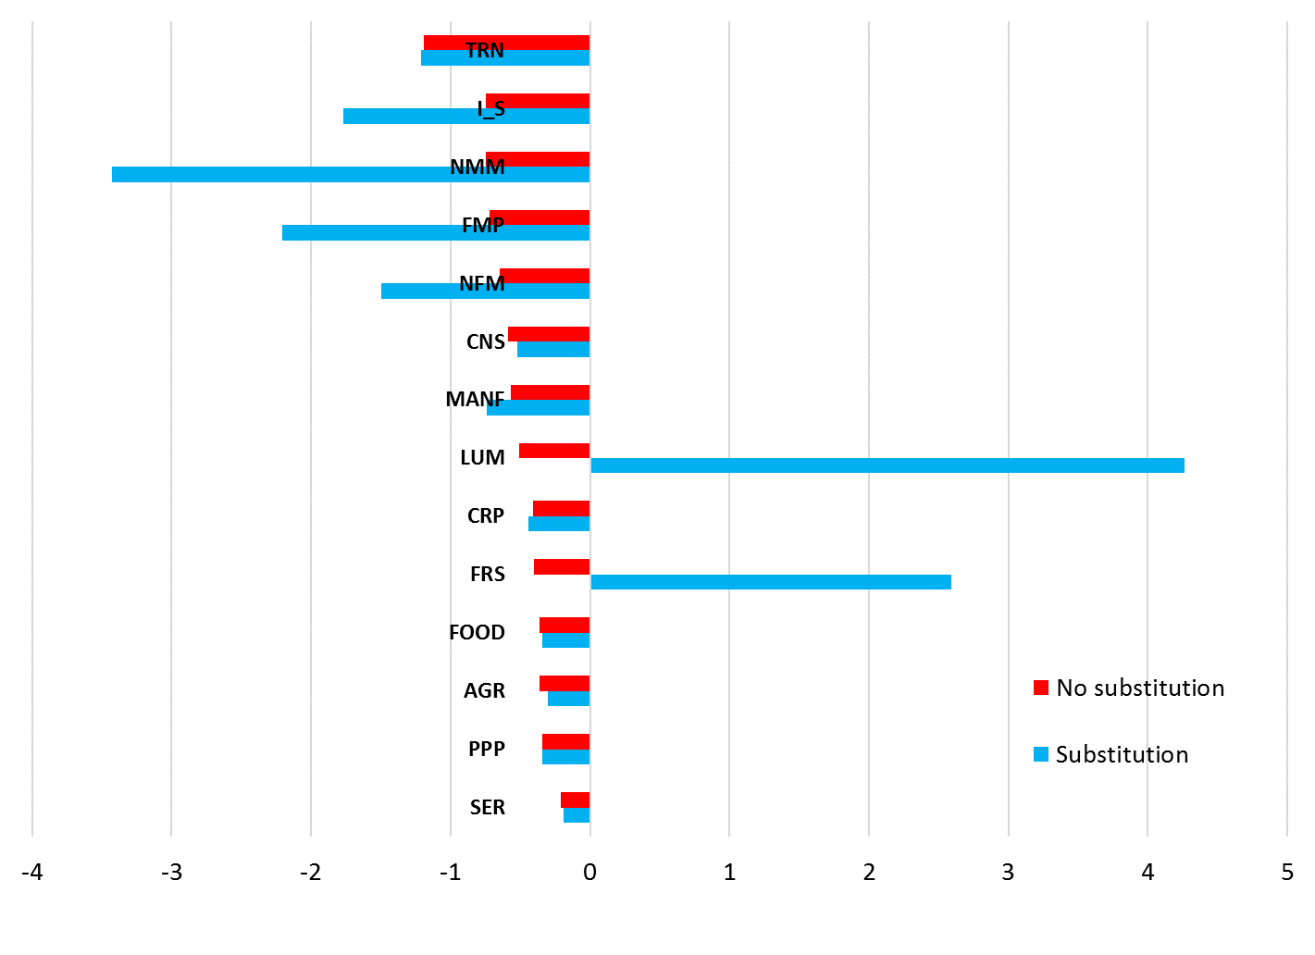
Output changes in 2030 relative to the Business as Usual, %
Iron and steel
Cement
Aluminium
Construction
Lumber
Forestry

Slide 18
Results
2. Land use change
Production of biofuels and using more wood in construction raises land-use change issues
Could increased demand for land lead to the loss of natural forests and ultimately an increase in CO₂ emissions?
Winchester and Reilly (2015)* analyzed the environmental implications of a large-scale global biomass industry (~150 exajoules of primary bioenergy)
Found that incenting bioenergy production lead to deforestation in regions that did not protect natural forests, but pricing emissions from land use change lead to afforestation
* Winchester, N. and J.M. Reilly (2015). The feasibility, costs, and environmental implications of large-scale biomass energy, Energy Economics, 51, 188-203.

Slide 19
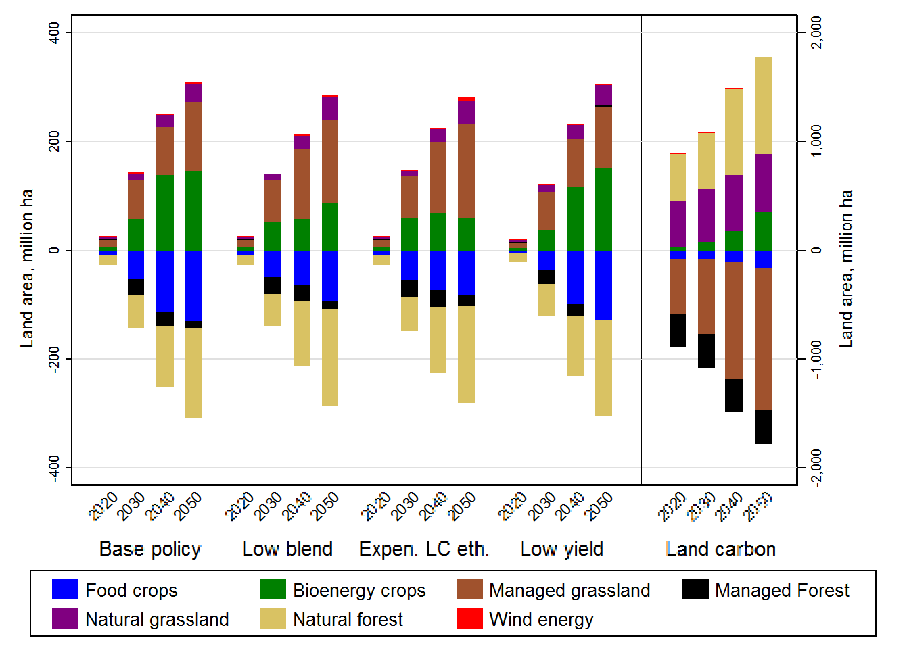
Results
2. Land use change
Change in global land use
Price on emissions from land use change
Production of biofuels and using more wood in construction raises land-use change issues?
Could increased demand for land lead to the loss of natural forests and ultimately an increase in CO₂ emissions?
No price on emissions from land-use change

Slide 20
Outline
Aviation
Construction
Land use change

